Slide 1
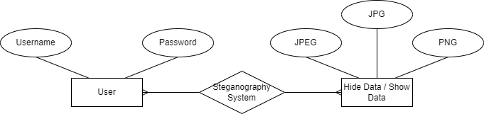
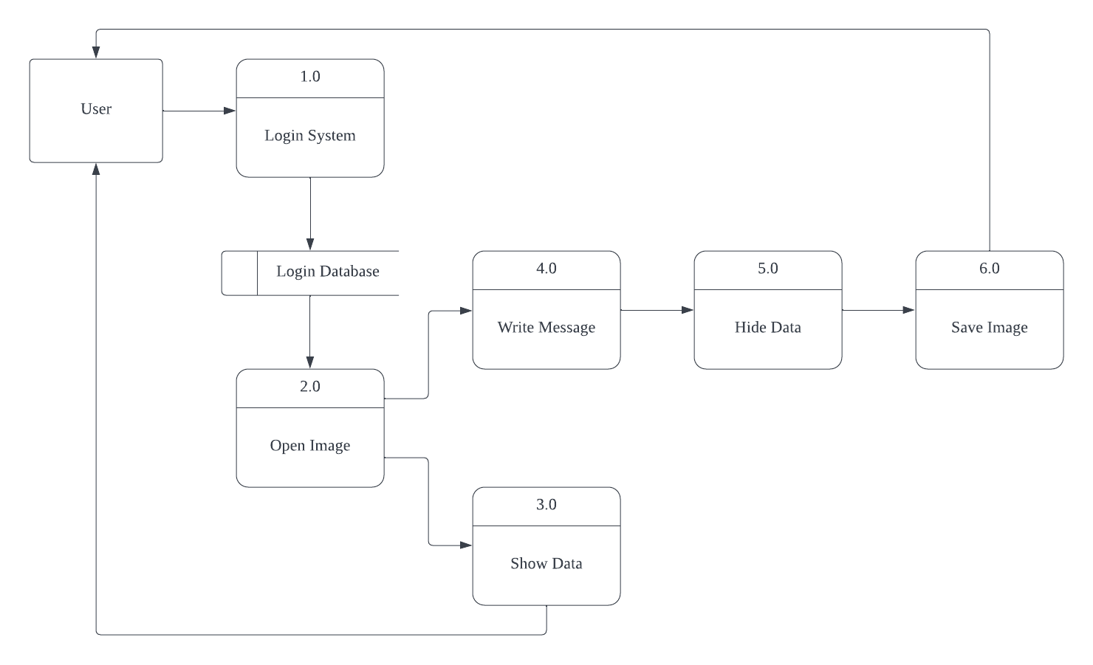
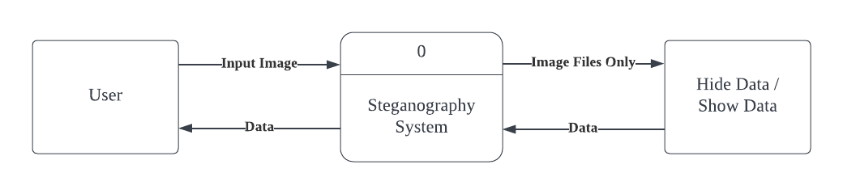
Steganography System
Introduction
Research
Conclusion
Questionnaire Survey
Problem Statement
Recommendations
Objectives
DIPLOMA IN COMPUTER FORENSICS
Project Submitted in Partial Fulfilment of the Requirements for the diploma of Diploma in Computer Forensics in the Faculty of Information Sciences and Engineering
The role and importance of security and privacy in online communications cannot be understated since most of the human population uses the internet and the platforms built around it for communicating. Recently the rate of data breaches have been increasing.
There are not a lot of options when it comes to having absolute privacy, security, and control over ones own data online. This project is trying to recoup some form of control that isn’t much of a hassle for anyone so they may incorporate it into their lives when they deem necessary. Among surveyed the mindset of protecting one's self and one’s privacy against such mishap is present. The system created may not be bullet proof against a focused attacker but it will increase one’s security of transmitting information online and that is an important base to build upon.
Where steganography plays a role is in incoorporating with other security systems such as crypthography in helping increase the security and privacy of sending data online.
The data leaks done by black hats.
Limited privacy from big tech.
Relay of information.
There should be an increase in research on methods of improving security and privacy online.
There should also be an increase in development of security systems that is more user friendly.
To create a system for which users can mask and unmask messages using steganography.
To provide users of additional layer of security and privacy.
This template was created by Slidesgo

